Slide 1
Course-Hub
Indranil Guha, Abhijeet Kharkar, Nabeel Khan, Ali Asgher

Slide 2
Overview
Technology & Architecture
Product Testing
Sprint Retrospective
Demo

Slide 3

What is Course-Hub?
Central Catalog for Online Courses
Uniform course review and rating platform
Platform to Compare Multiple Courses
Runs on an advertisement-based model
User posted course deals
Micro-degree recommendation
Auto-suggestion of courses at search time
Favorite courses

Slide 4


Methodology
Agile Methodology is followed
Github is used for code base management
Zenhub is used to create stories, task and track sprint progress
Pull Requests(PR) merged after at least 1 review
Product owner is responsible for merging PR
Each PR should have appropriate testing for the functionality.

Slide 5
Overview
Technology & Architecture
Product Testing
Sprint Retrospective
Demo

Slide 6

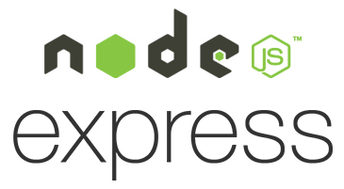








Technologies Used
Services
Frontend
Backend
aws lambdas
Database
Elastic Search(aws)
Auth Service
Firebase
Infrastructure
Semaphore CI
Code Climate
Docker
Google Cloud
Kubernetes

Slide 7
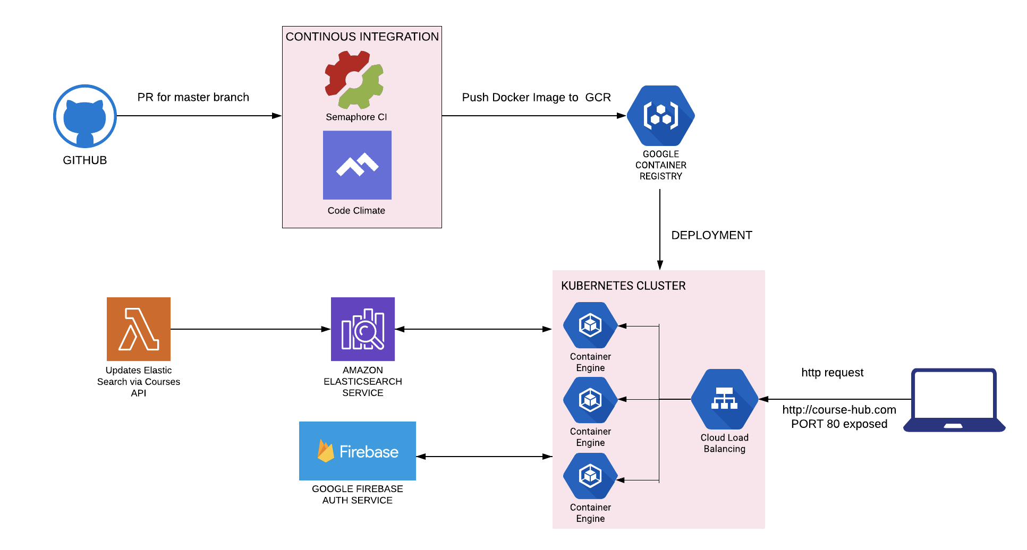
Architecture

Slide 8
Overview
Technology & Architecture
Product Testing
Sprint Retrospective
Demo

Slide 9



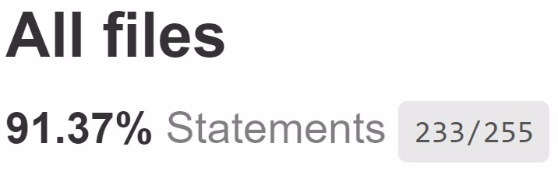

Unit testing
Jest & Enzyme
NodeJS and ReactJS
Python Unit Test
aws lambda
Code Coverage
Backend Coverage (91%)
Frontend Coverage (88%)
aws lambda Coverage (92%)
Code coverage tool: Istanbul
Overall code coverage: 89%

Slide 10


Functional & Load Testing
Functional Testing using Selenium
Number of scenarios covered : 26
Load Testing
Using Apache JMeter
Tested Backend API
Search and autosuggest APIs are tested

Slide 11
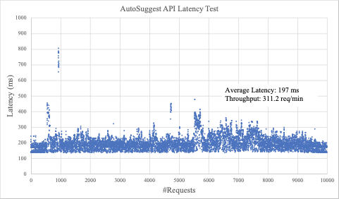
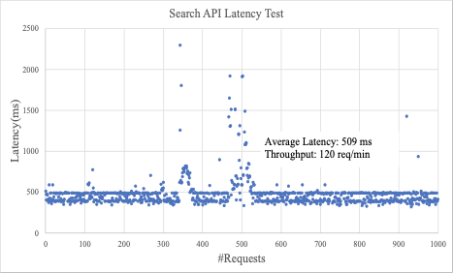
Load testing

Slide 12
Overview
Technology & Architecture
Product Testing
Sprint Retrospective
Demo

Slide 13
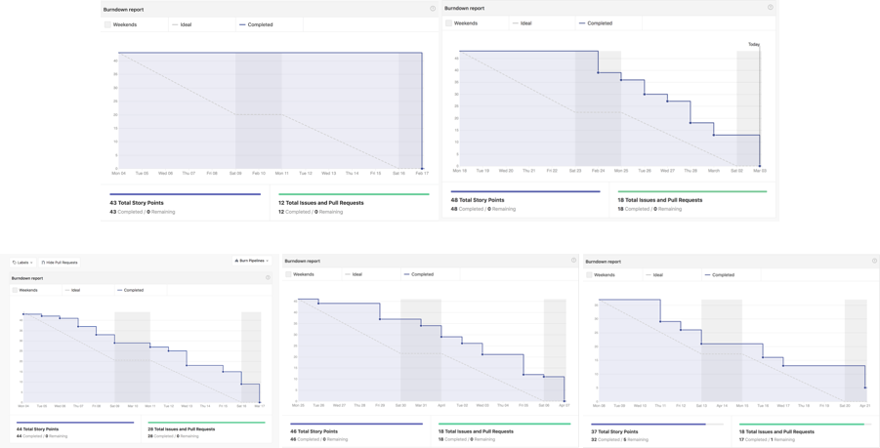
BurnDown Charts

Slide 14
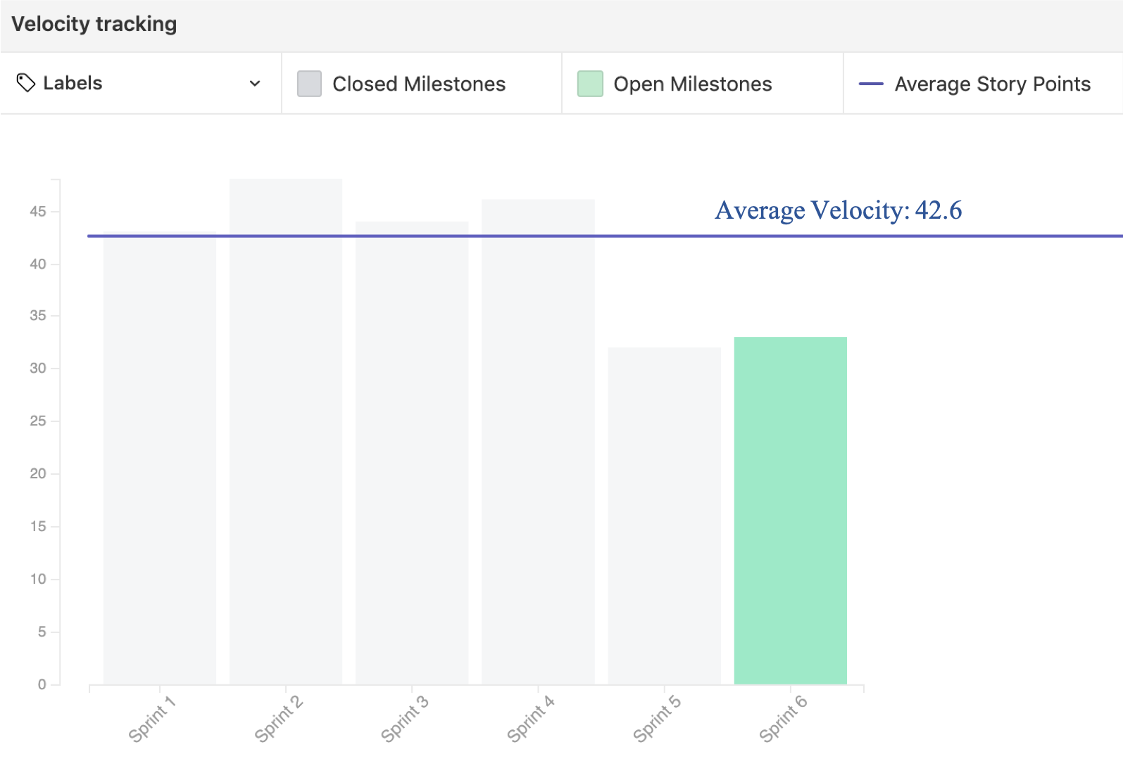
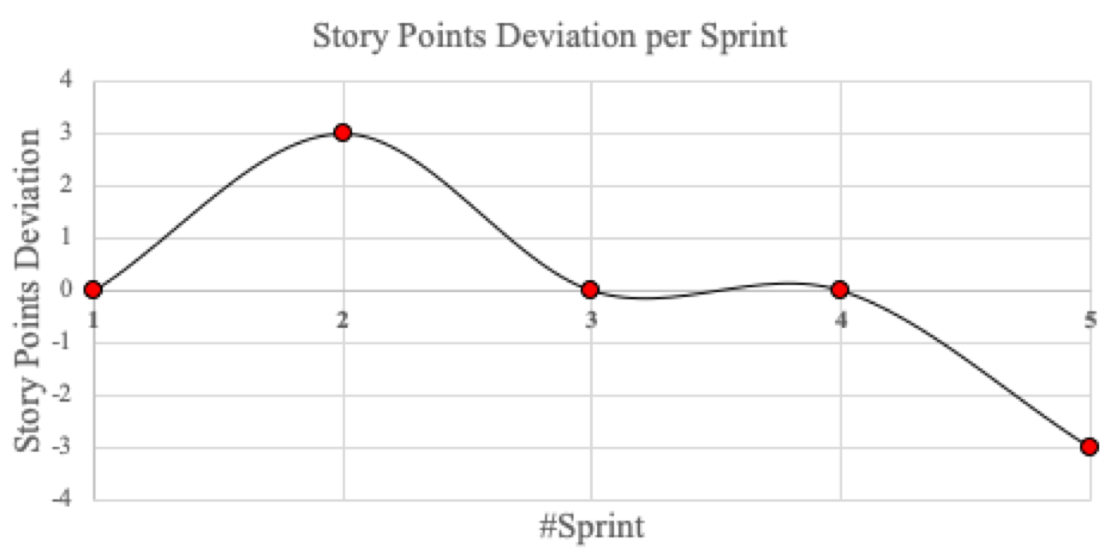
Velocity
Total story points covered: 213/215

Slide 15
Process Assessment
Strengths
Tried to learn & followed guidelines set in Wiki (Coding, Name Protocols & Issues)
Brainstorming session helped to come up with additional features
Learned new Tools & Technologies
Team Work
Healthy knowledge transfer
Weakness
Guidelines to define Task atomicity.
Preferred line coverage over quality testing.
Resource availability before sprint planning.
Screenshots should have been added with FrontEnd PR.
Code does not have structured comments.
Notes:
Flexible Timing - Team Work

Slide 16
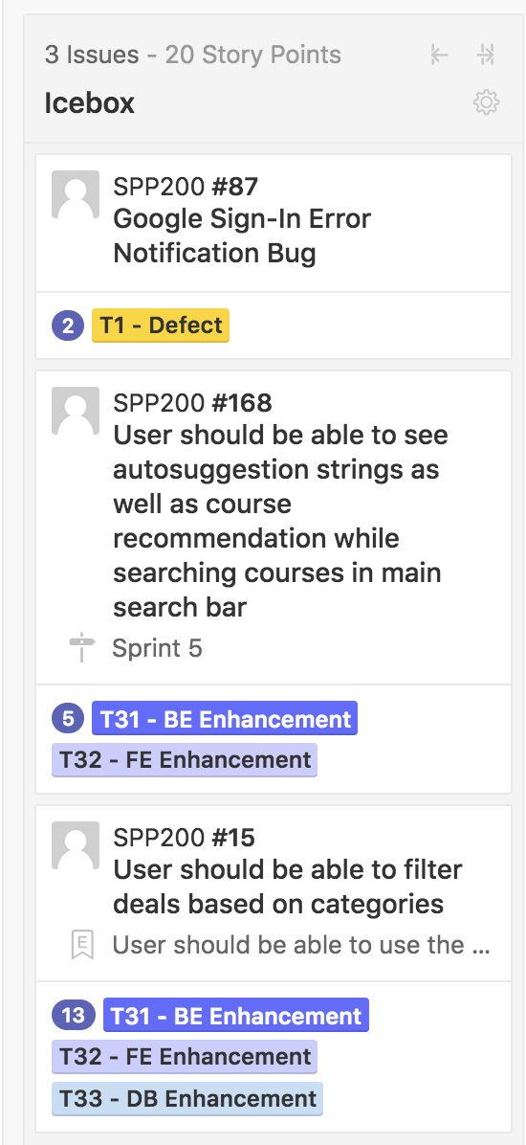
Lessons Learned
Atomic Tasks
If it’s not tested, It’s broken
Through Brainstorming & Research before finalizing a feature.
Clean Code & Comments should be a priority.
Importance of Design
Notes:
Taxonomy

Slide 17
Demo

